Slide 1
FY 2027 All-Hands Kick-Off
April 14th 2027
Mark Rittman, CEO
Lewis Baker, COO/CRO
Lydia Blackley, HoD

Slide 2
Agenda
Review of 2025
Goals and objectives for 2026
Sales & Partner Strategy - Lewis
Delivery Strategy - Lydia
KPIs and OKRs - Preview and tbc - Mark

Slide 3
Review of 2025

Slide 4
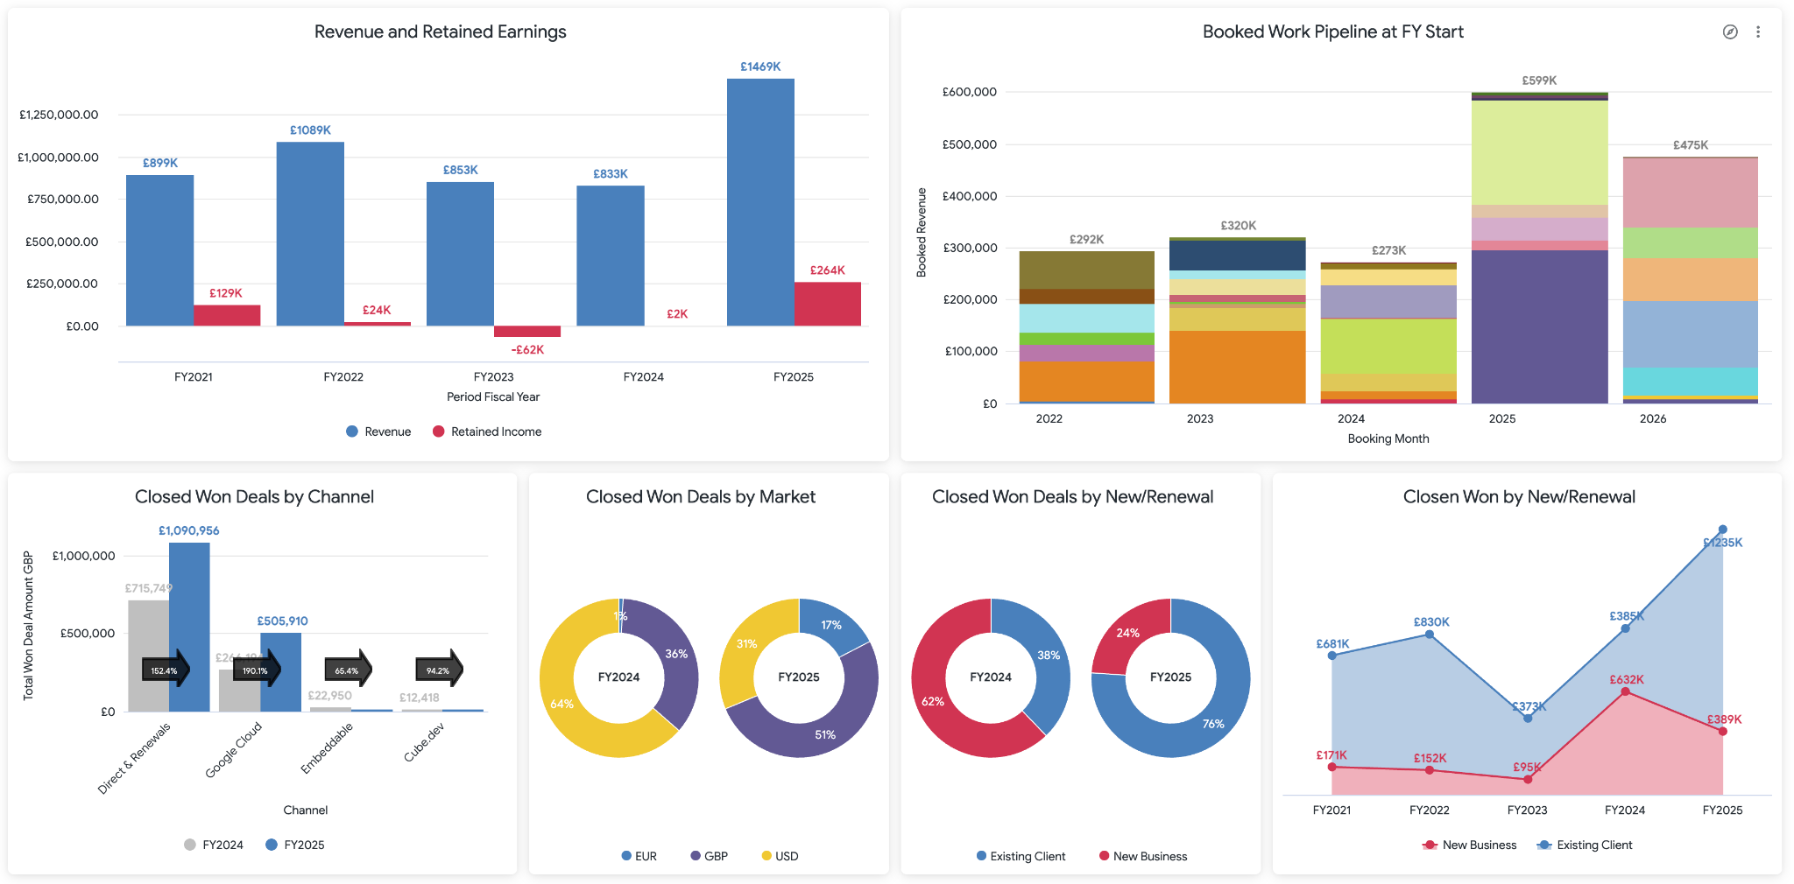
Revenue and Sales
The Year in Numbers

Slide 5
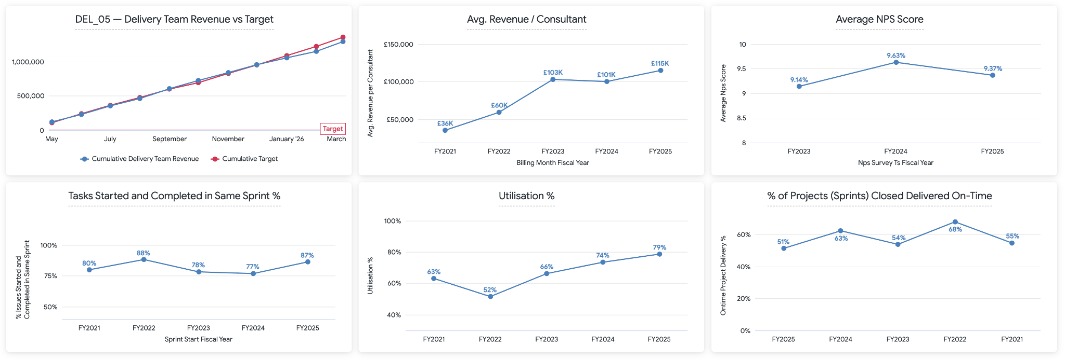
Delivery Team Revenue and Efficiency
The Year in Numbers

Slide 6

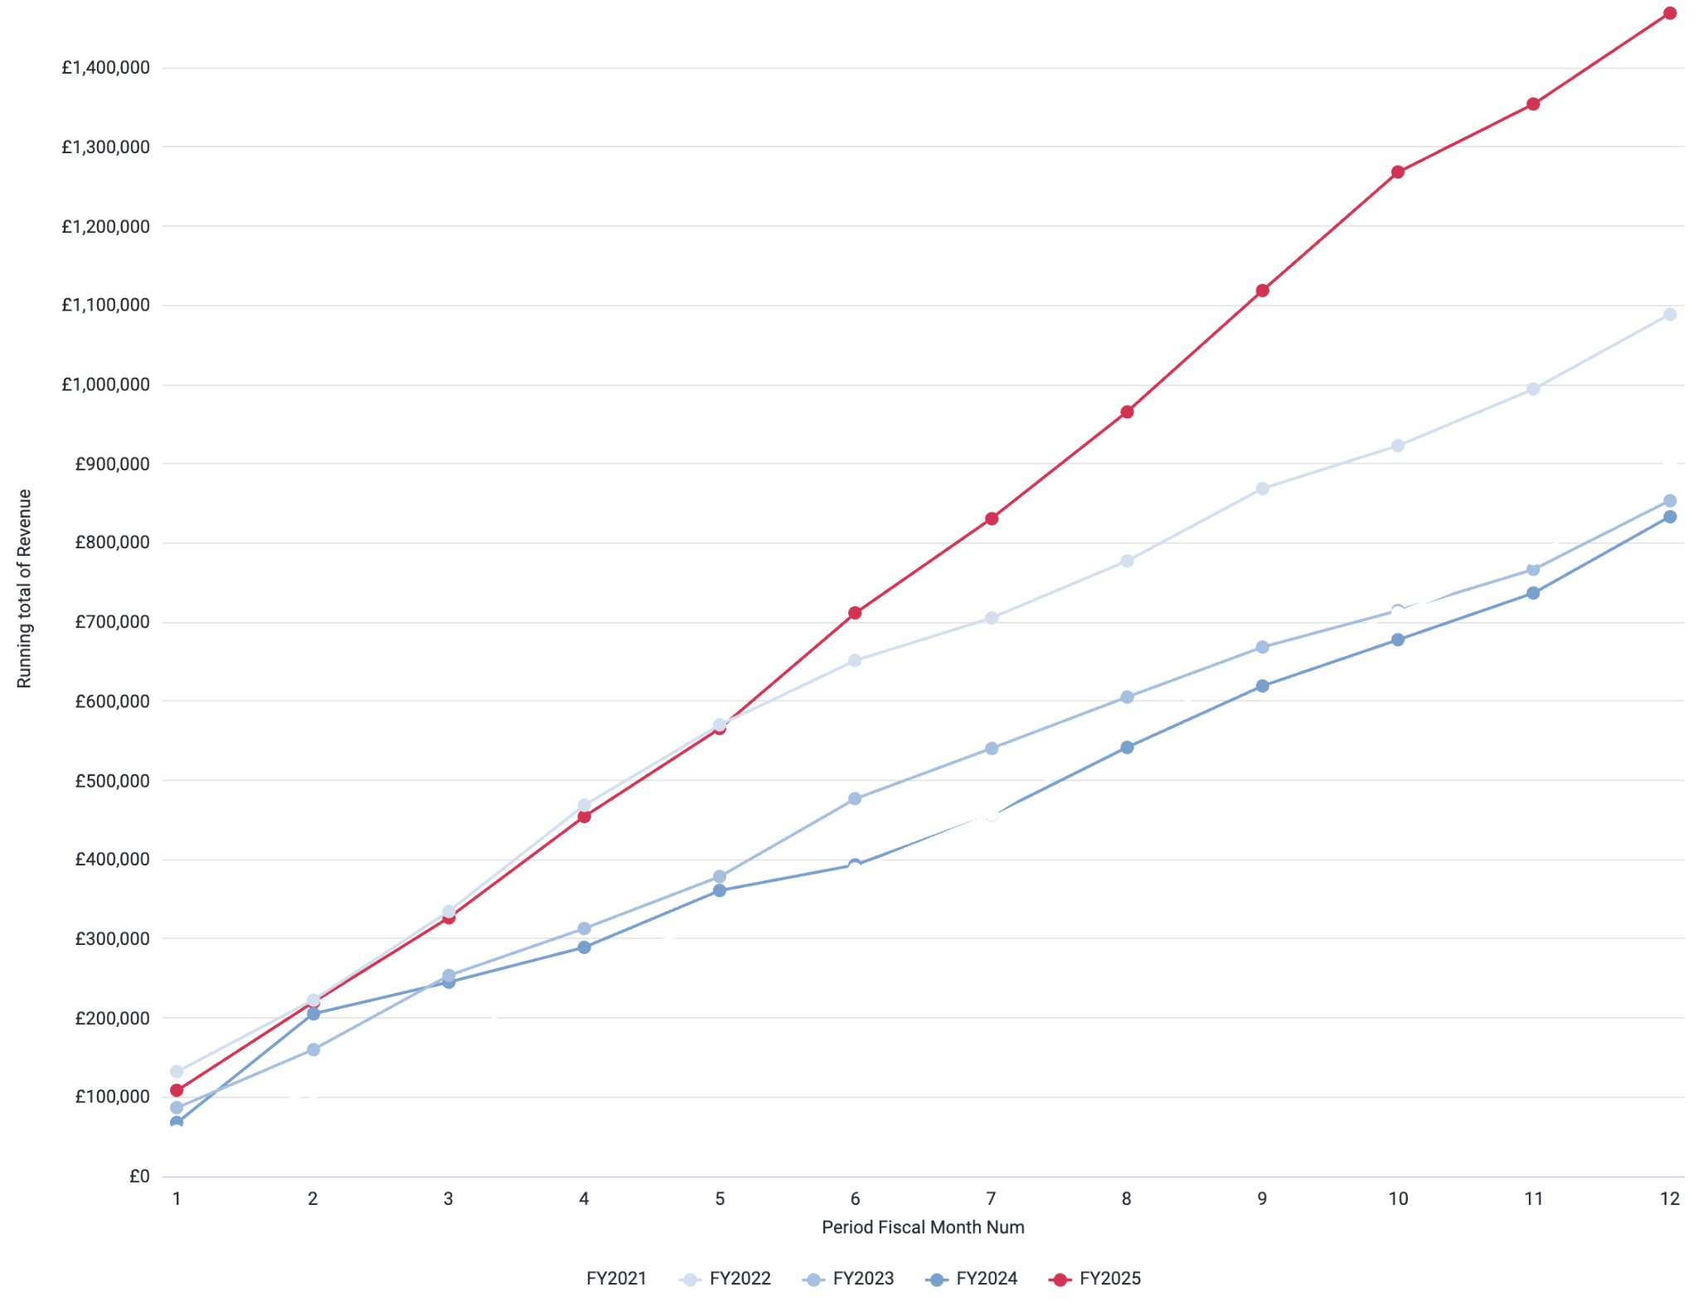
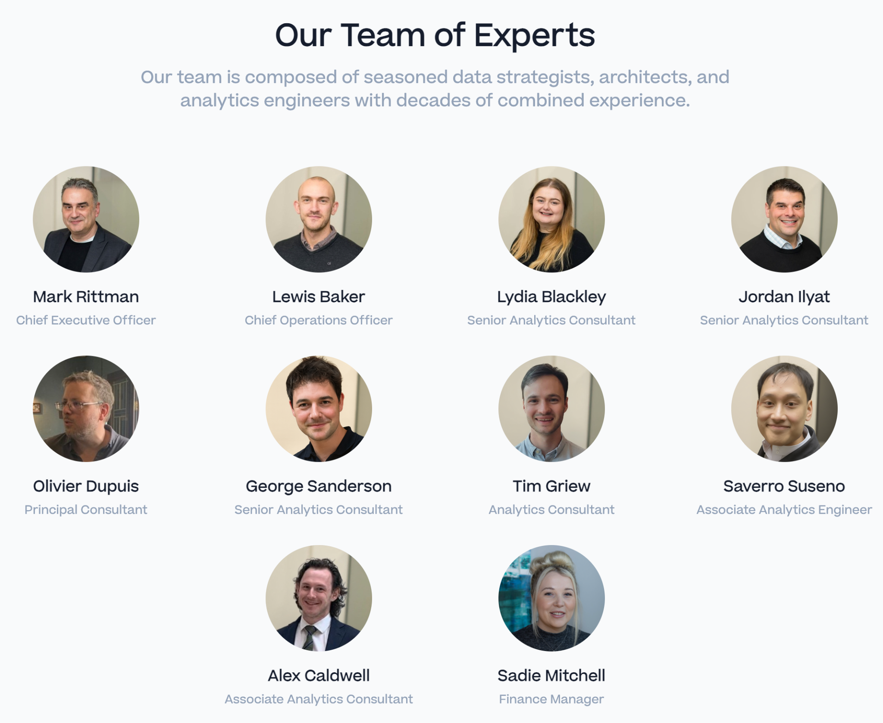




It’s Been A Record Year - Well Done!

Slide 7
Targets and Goals for 2026

Slide 8
Targets for FY 2026/2027
Revenue : £1.7m (up from £1.46m, a 17% increase on last year)
  Includes an assumed £450k from winning Carwow in April 2026
Retained earnings : keep to 15%, ~ same as this year
Average monthly revenue of £145k (£101k excluding Carwow)
Same staffing level as today (excluding replacements)
  Carwow would be largely resourced using contractors
  Assumption that AI / Wire will also increase productivity

Slide 9



Make delivery predictable
Sprints finishing on time is not the same as a project being on track. From Q2 we manage delivery at two levels : sprint and milestone : and every engagement has a defined schedule from day one.
Delivery Team Strategy
Every engagement has a milestone schedule
Defined within 10 days of kickoff. If the client hasn't provided one, we propose one. First deliverable agreed at the same time. Keeping it small enough to ship fast, meaningful enough to matter.
Manage sprints and epics — not just sprints
Track health at both levels. A project is green when the milestone is intact not just because last week's sprint closed. T&M and fixed-price engagements are managed differently; neither runs itself.
Red for 14 days needs a recovery plan
Any engagement red for 14+ consecutive days without a written recovery plan is a delivery failure. The plan needs one thing: honesty about the cause, a specific action, and a named owner.

Slide 10
Adopting AI as a competitive advantage
Delivery Team Stratgey
AI in delivery is now an expectation, from clients and from the business. The goal is not adoption for its own sake. It is a measurable speed and quality advantage we can point to.
Clients are asking - Prospects want live demos of AI-powered analytics. Rapha has a Vertex AI opportunity in front of us right now.
We have the tools - Wire Framework. Wire can take a SOW and deliver a complete dbt project, LookML, and QA checks autonomously.
The gap - Adoption is inconsistent. Not everyone is using Wire on every engagement. That changes in 2026.
We have:
Wire Framework
The Gap:
Inconsistent use
Low library contribution
The Goal:
Wire on every engagement
Team contributing back
Gemini in client work

Slide 11



How we get there
Delivery Team Strategy
AI is the default, not the exception
Wire applies to every engagement. At kickoff we agree how AI will be used — not whether. Code review, documentation, testing, data workflows. The form changes; the expectation does not.
Contribute back to the shared library
Every consultant contributes at least one reusable skill, prompt, or pattern per quarter. Learning something and keeping it to yourself is not good enough. The framework only compounds if we contribute back.
Get hands-on with Gemini and Vertex AI
We need real delivery experience with GCP AI tools — not just mentions in proposals. Look for opportunities on active engagements and document what works as a pattern for the team.

Slide 12
Prove our skills and expertise

Slide 13

Prove our skills and expertise
Delivery Team Strategy
Being good at the work is not enough if we cannot demonstrate it. Certifications and skill badges prove our expertise to clients who are assessing us, prospects comparing us to competitors, and partners deciding whether to refer us.
Client trust
Clients assess our credentials when deciding to renew. Certified consultants give them confidence in the team they're paying for.
Competitive edge
In a competitive pitch, certs are visible proof. An uncertified team in our space is an invisible one.
Partner referrals
Google's DRP tier scores — which drive referrals — are built directly from certifications and skill badges.

Slide 14
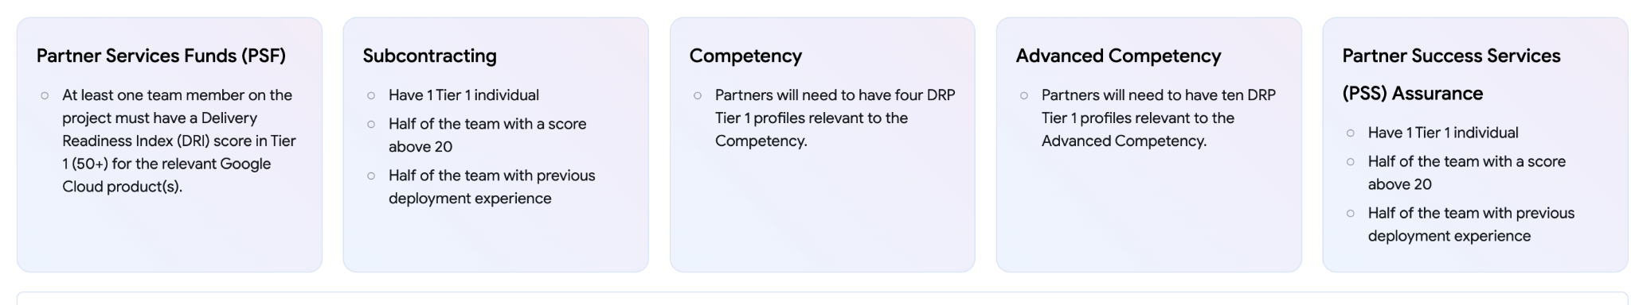
Why this Matters
Delivery Team Strategy
Our position in Partner Finder determines whether Google's sales team recommends us, or doesn't
231 searches/month
…but only…
17 top-5 appearances
We must maintain our Data Analytics competency and gain Looker and Gemini Enterprise competencies

Slide 15
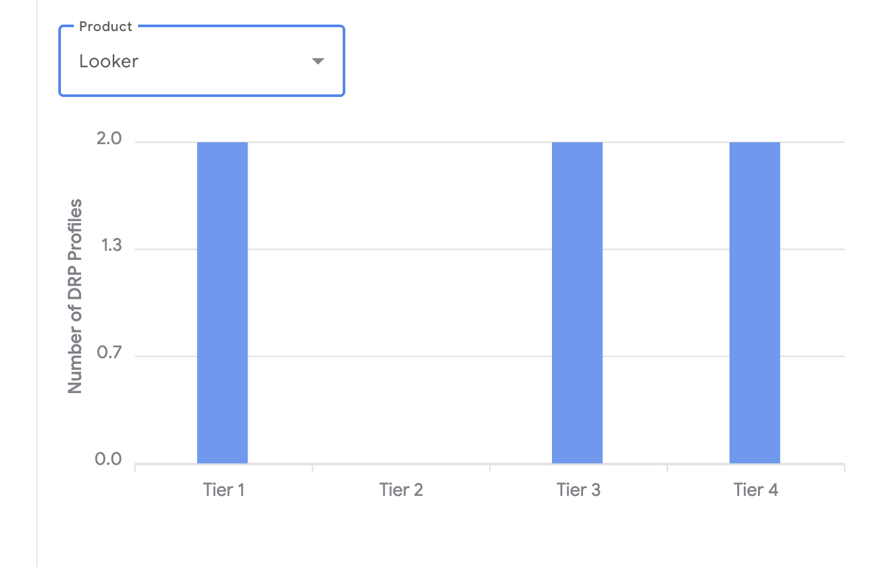
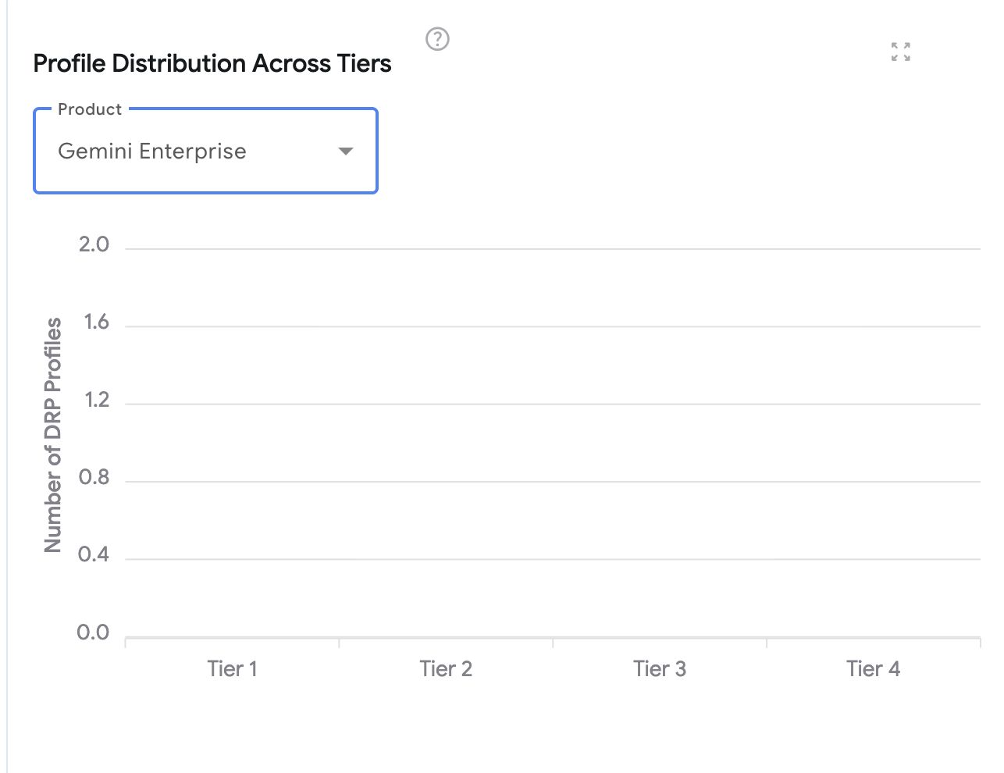
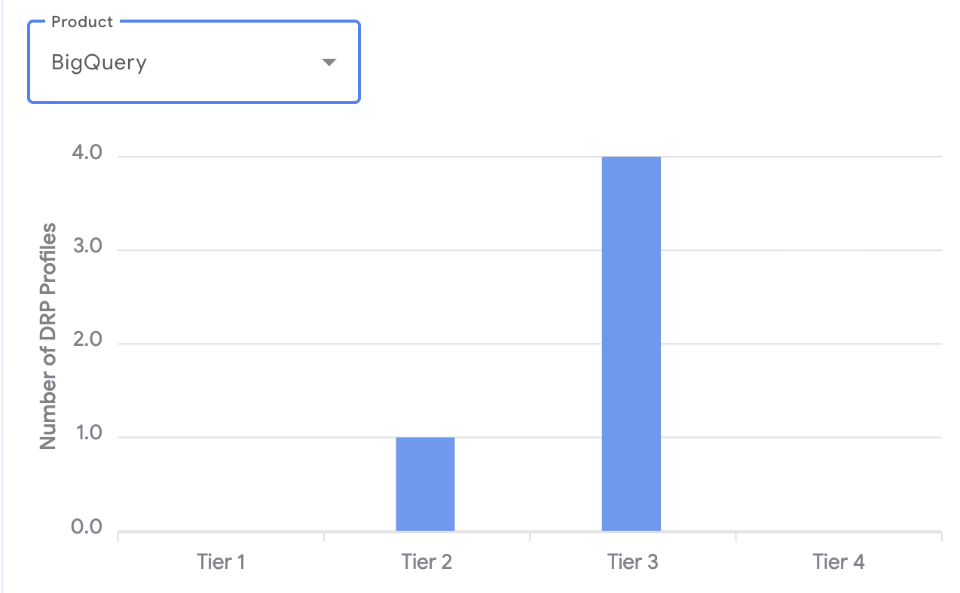
Where we stand today
Delivery Team Strategy
Our DRP profile doesn't reflect what we actually deliver. That changes in 2026.
Looker and BigQuery: we deliver these every day. Our team's profiles are spread across tiers, and not everyone has a profile at all. For our two core products, every consultant should be Tier 1. Closing this gap is our first priority.
Gemini Enterprise: we're starting from zero
No profiles, no tier. AI delivery is where the market is heading and we need to build our credentials here from the ground up. This is our second priority.

Slide 16
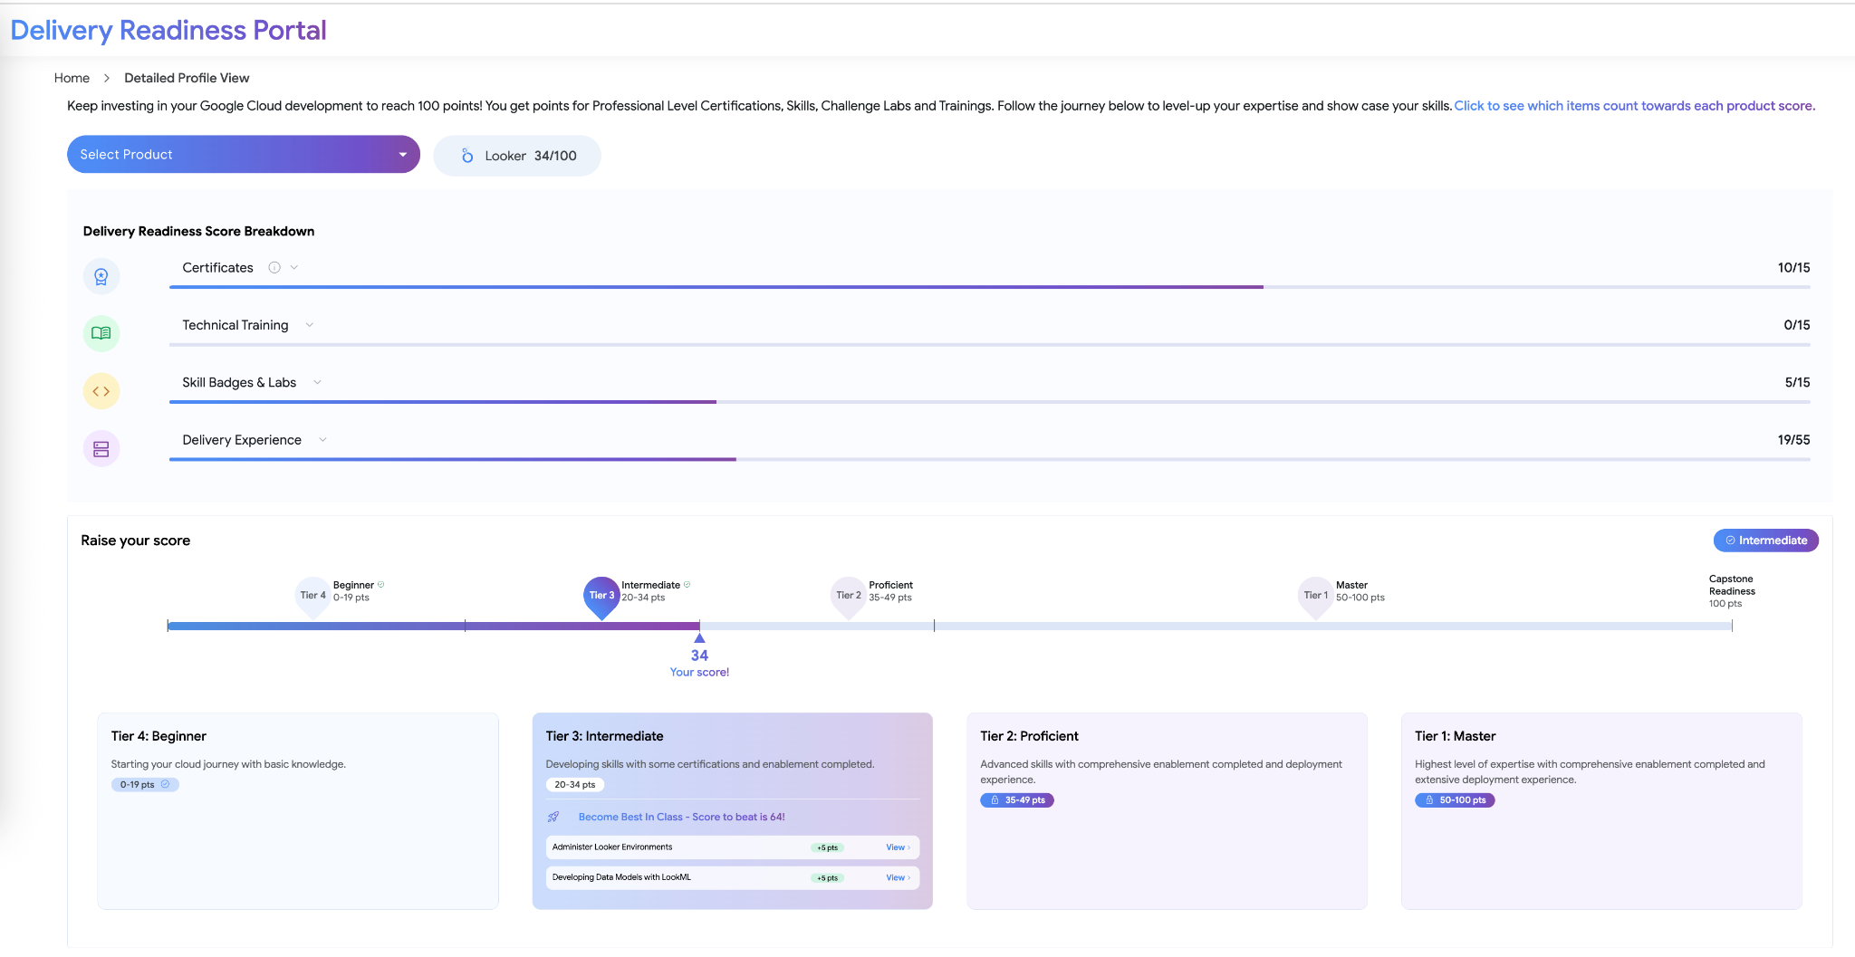
Google Delivery Readiness Portal — what we need to do
Delivery Team Strategy
Google scores every consultant in our team on their delivery readiness across GCP products. Right now, our scores for the products we use every day are too low.
Must achieve Tier 1 for:
Data Analytics Competency
  BigQuery
Looker Competency
  Looker
Gemini Enterprise Competency
  Gemini Enterprise

Slide 17
KPIs and OKRs
(details to be finalised)

